Slide 1

SEQUENCE TAGGING AND NAMED ENTITY RECOGNITION USING BIDIRECTIONAL LSTMS

Slide 2
INTRODUCTION
PRIMARY OBJECTIVES:
Process and prepare textual data for NER, ensuring missing values and discrepancies are adequately handled.
Design and implement a Bidirectional LSTM model, considering the specific needs of the NER task.
Train, evaluate, and validate the model using appropriate metrics and datasets to ensure its effectiveness and generalizability.
The goal is not only to build an effective NER model but also to discern the impacts of bidirectional LSTMs on sequence tagging tasks, especially in the context of NER. Through this research, we seek to push the boundaries of what's achievable in NER using Bidirectional LSTMs and TensorFlow.

Slide 3
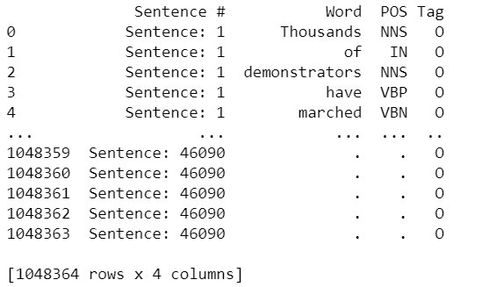
DATA ACQUISITION & CLEANING
LOADING DATASETS
HANDLING MISSING VALUES: FORWARD FILL METHOD
FORMING SENTENCES FROM FRAGMENTED DATA

Slide 4
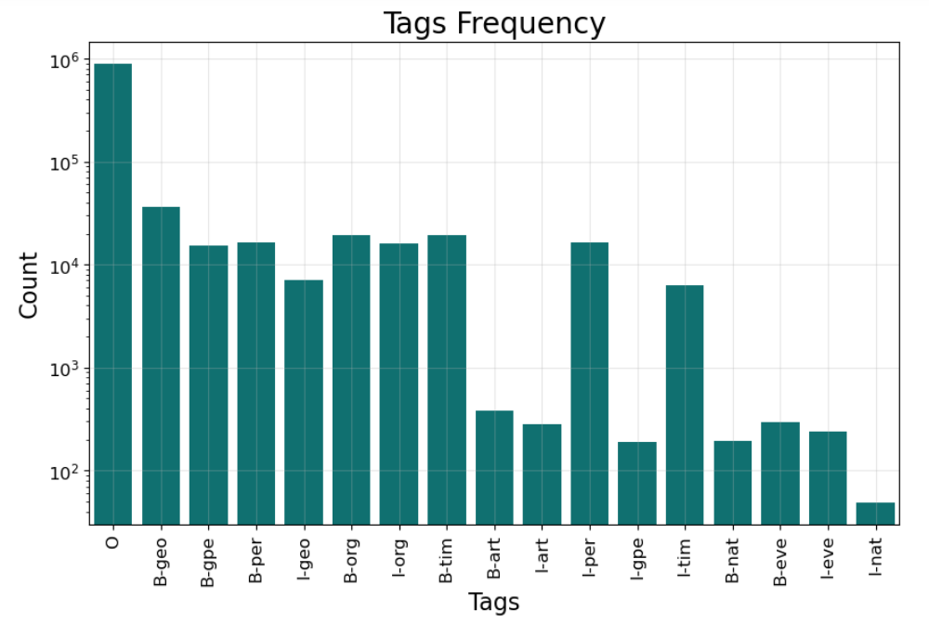
UNDERSTANDING THE DATA: EXPLORATORY DATA ANALYSIS
DATASET SIZE: (1048364,4)
NUMBER OF UNIQUE TAGS: 17
TAG FREQUENCIES:

Slide 5
TOKENIZATION & SEQUENCING
CONVERTING SENTENCES INTO TOKENS FOR THE MODEL.
PADDING THE SEQUENCES FOR A CONSISTENT INPUT LENGTH.
CONVERTING TAGS INTO INDICES.

Slide 6
MODEL ARCHITECTURE
1.EMBEDDING LAYER
CONVERTS WORD INDICES INTO VECTORS, DIMENSIONS:350, VOCABULARY SIZE: 36,000, SEQ LENGTH: 110
2. BIDIRECTIONAL LSTM (1ST LAYER)
PROCESSES SEQUENCES IN BOTH DIRECTION, UNITS: 100, ACTIVATION: ‘TANH’
3. BIDIRECTIONAL LSTM (2ND LAYER)
ADDS DEPTH, CAPTURING COMPLEX PATTERNS, UNITS:100, ACTIVATION: ‘TANH’
4. TIMEDISTRIBUTED DENSE LAYER
APPLIES DENSE LAYER AT EACH TIME STEP, TAGS: 7, ACTIVATION: ‘SOFTMAX’

Slide 7
MODEL TRAINING & EVALUATION
1. TRAINING DATA SPLIT: 80% TRAINING, 10% VALIDATION, 10% TESTING.’
2. RANDOM SEED SET TO 200 FOR REPRODUCIBILITY.
3. TRAINING DYNAMICS:
OPTIMIZER: ADAM
LOSS FUNCTION: SPARSE CATEGORICAL CROSS-ENTROPY
METRICS: SPARSE CATEGORICAL ACCURACY
EPOCHS: 10
4. EVALUATION: MODEL.EVALUATE() TO DETERMINE LOSS AND ACCURACY

Slide 8
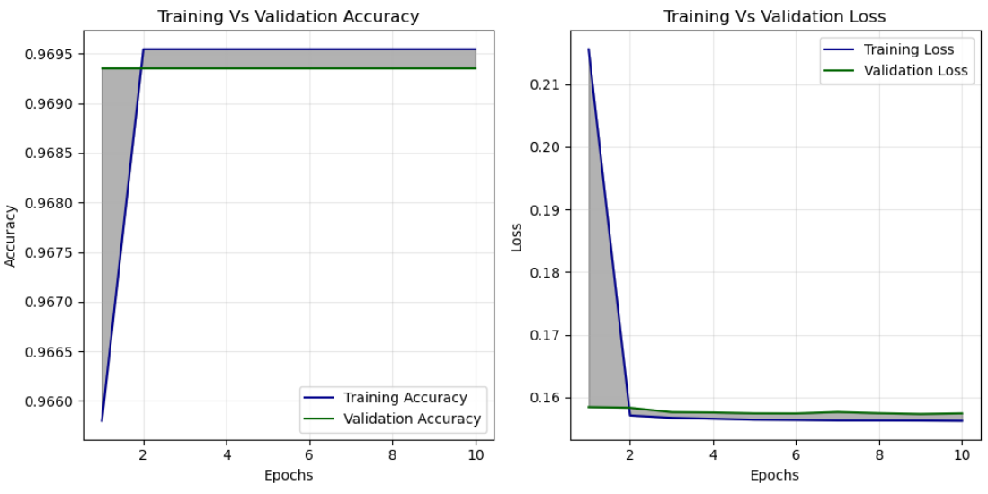
MODEL TRAINING & EVALUATION

Slide 9
RESULTS
1. Achieved a high test accuracy of 96.97%, indicating a strong ability to correctly predict tags of tokens.
2. The loss value of the model is 0.1561 which highlights it’s effectiveness.

